Slide 1
PYTHON PROJECT
G-10 MENTORING CSE
TEAM-7

Slide 2
COLOR DETECTION PROJECT
This project and presentation for partial fulfilment of
PROBLEM SOLVING USING PYTHON PROGRAMMING
SESSION 2022-23
BY
Mannit Singh Goyat : (2210991860)
Madhav Sharma : (2210991862)
Madhav Garg : (2210991863)
SUPERVISOR
DR.SANJOY KUMAR DEBNATH
INSTITUTE OF ENGINEERING AND TECHNOLOGY
DEPARTMENT OF COMPUTER SCIENCE AND ENGINEERING
CHITKARA UNIVERSITY , RAJPURA ROAD , PUNJAB
Notes:
Create an outline to get ready:
Introduce the era (Use a mix of media and text)
Organize your artifacts to outline what life was like during the era you are presenting
Think about using a storyboard to outline your images and ideas
Make sure you prepare a clear and well rounded presentation of all aspects of the era (People, jobs, food, transportation, etc. What else should you include so the audience feels like they have visited your era?)

Slide 3



INTRODUCTION
Color detection is the process of detecting the name of any color. Simple isn’t it? Well, for humans this is an extremely easy task but for computers, it is not straightforward. Human eyes and brains work together to translate light into color. Light receptors that are present in our eyes transmit the signal to the brain. Our brain then recognizes the color. Since childhood, we have mapped certain lights with their color names. We will be using the somewhat same strategy to detect color names.

Slide 4
AIM AND OBJECTIVE
In this color detection Python project, we are going to build an application through which you can automatically get the name of the color by clicking on them. So for this, we will have a data file that contains the color name and its values. Then we will calculate the distance from each color and find the shortest one.

Slide 5
METHODOLOGY
Colors are made up of 3 primary colors; red, green, and blue. In computers, we define each color value within a range of 0 to 255. So in how many ways we can define a color? The answer is 256*256*256 = 16,581,375. There are approximately 16.5 million different ways to represent a color. In our dataset, we need to map each color’s values with their corresponding names. But don’t worry, we don’t need to map all the values. We will be using a dataset that contains RGB values with their corresponding names.

Slide 6
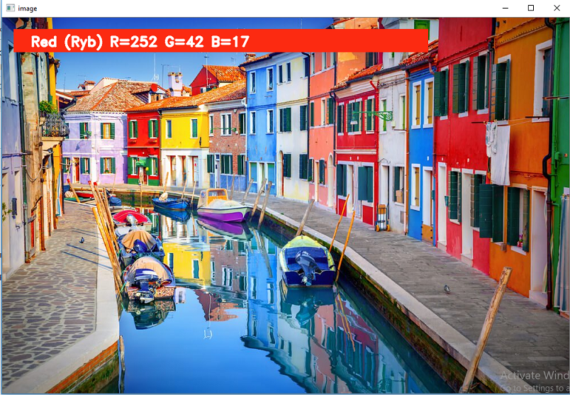
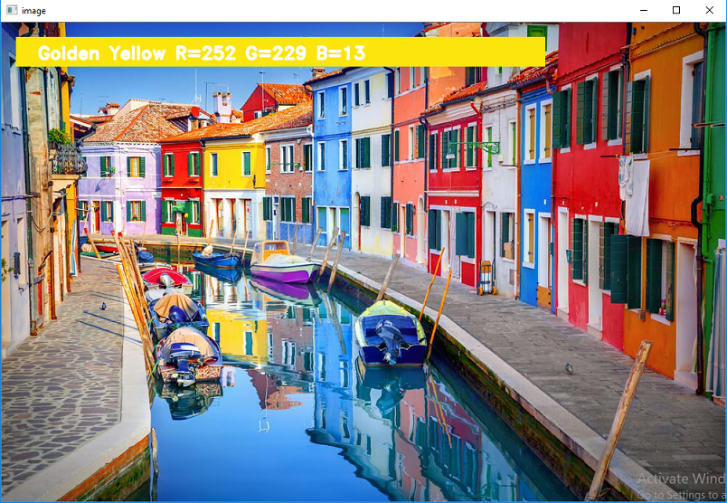
RESULT AND ANALYSIS

Slide 7
CONCLUSION
In this Python project with source code, we learned about colors and how we can extract color RGB values and the color name of a pixel. We learned how to handle events like double-clicking on the window and saw how to read CSV files with pandas and perform operations on data. This is used in numerous image editing and drawing apps.

Slide 8
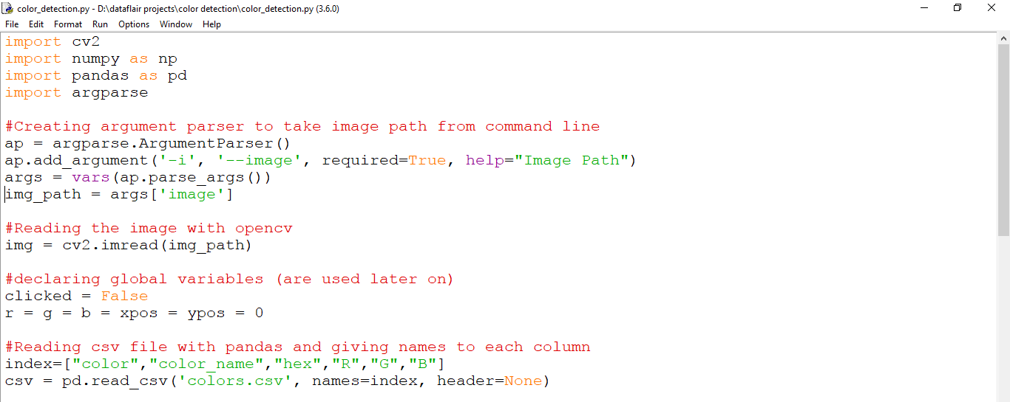
APPENDIX

Slide 9
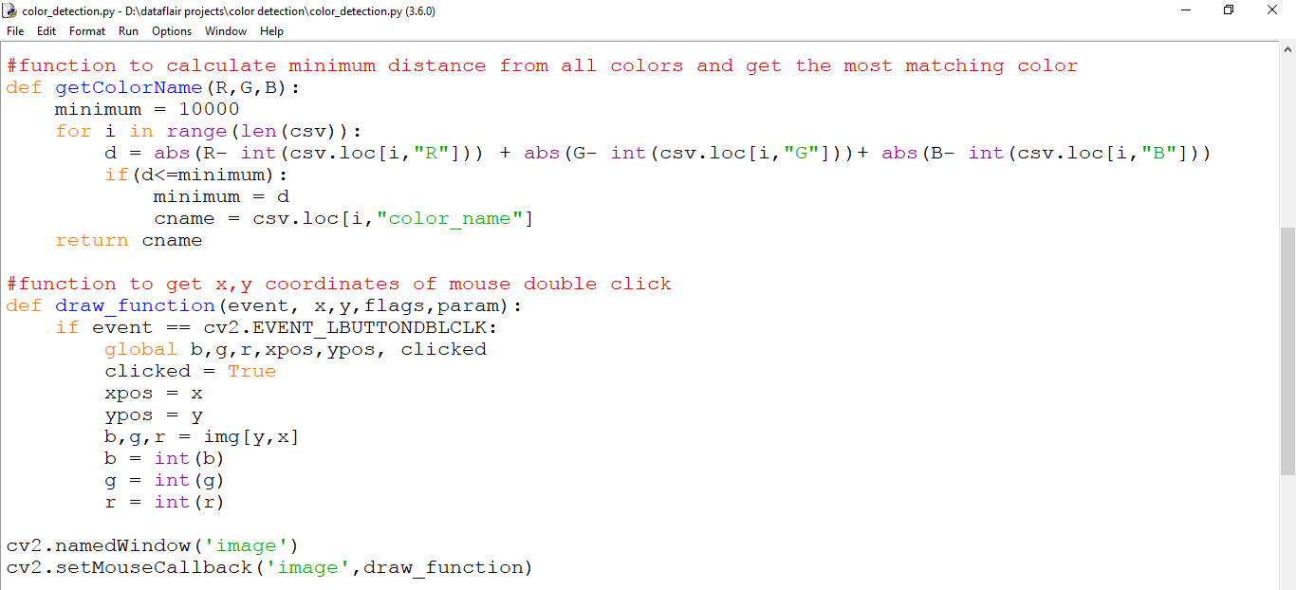

Slide 10
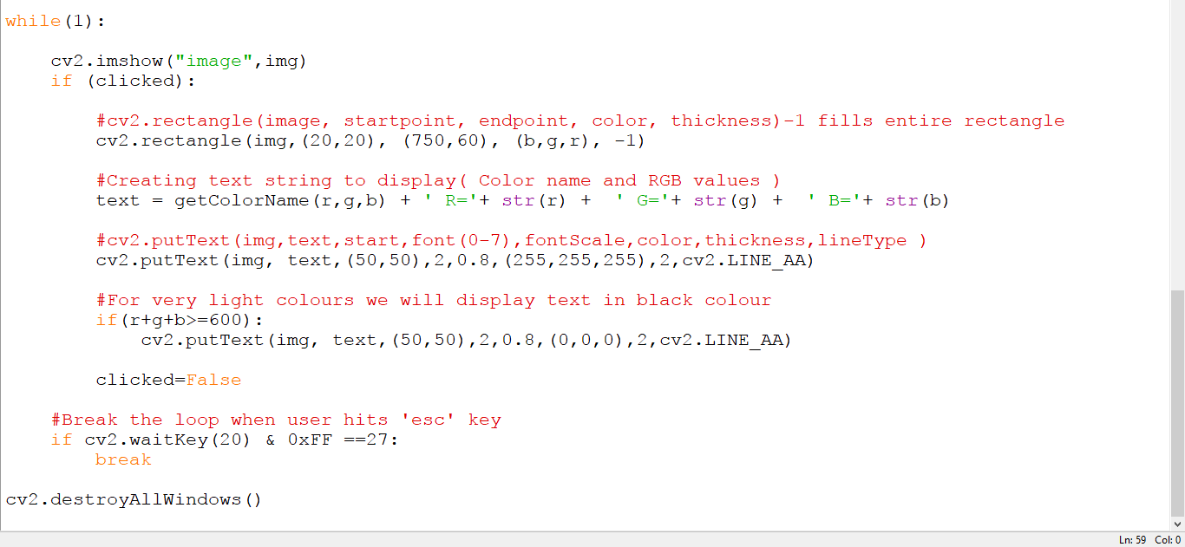

Slide 11
REFRENCES
[1] David Beazley
BOOK WRITTEN -
Addison-Wesley Professional; 717 pages (July, 2009)
[2] Guido van Rossum, and Fred L. Drake, Jr. (Editor)
BOOK WRITTEN –
Network Theory Ltd, 120 pages (Revised November 2006)
[3] www.geeksforgeeks.org

Slide 12
THANK YOU

